Slide 1
Agenda
System Call

Slide 2
System Call
Why ?????
To perform Following activities
There is no open access to the kernel code for the user
Any user or application request that involves access to any system resource must be handled by the kernel code.
When program needs to access restricted resources.
Access to hardware devices like scanner, printer, need a system call.
If a file system requires the creation or deletion of files, reading and writing from files
Creation and management of new processes.
Network connections also require system calls. This includes sending and receiving packets.
The system call interface layer contains entry point in the Kernel code.
Services Provided by System Calls :
Process creation and management
Main memory management
File Access, Directory and File system management
Device handling(I/O)
Protection
Networking, etc.

Slide 3
What System Call
It provides an interface between a process and operating system to allow user-level processes to request services of the operating system.
A system call is the programmatic way in which a computer program requests a service from the kernel of the operating system it is executed on.
A system call is a way for programs to interact with the operating system. A computer program makes a system call when it makes a request to the operating system’s kernel.
System call provides the services of the operating system to the user programs via Application Program Interface(API).
System calls are the only entry points into the kernel system.
All programs needing resources must use system calls.

Slide 4
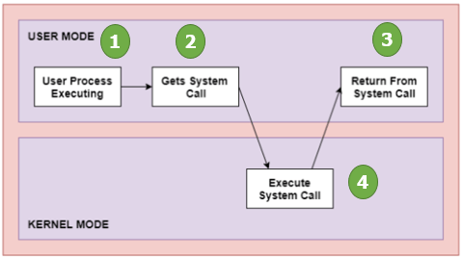
General Working
The processes executed in the user mode till the time a system call interrupts it.
After that, the system call is executed in the kernel-mode on a priority basis.
Once system call execution is over, control returns to the user mode.,
The execution of user processes resumed in Kernel mode.

Slide 5
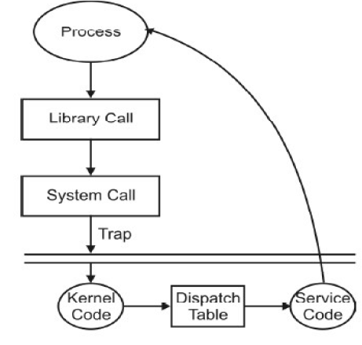
Internal Working
When user program wants to take services from OS e.g., Read, system, call.
User program makes a call to the library functions.
Then Library routine puts appropriate parameter at a well known place (e.g., Register, stack, Table in main memory).
It passes library parameter or system call number.
The trap instruction is executed to change mode from user to kernel.
Then control goes to O.S. after that OS determine which system call's is to be carried out (by system call no.).
Then kernel index to dispatch table which contents pointer to service routine for system call.
After that service routine is executed and return parameter or error code are place at well-known place usually a CPU register.
At the last control goes to user process.
A library function executes the instruction followed by the trap.

Slide 6
Thank You
We will meet Soon!!!!!!!!!!

Slide 7
Agenda
System Call Types

Slide 8
Types of System call
Process control system call
Creation of processes, Termination of process
Abort of process, End of process.
Load of process, execution of process
Get process attributes, set process attribute
Wait for time, wait event, signal event.
Allocation and De-allocation of memory.
File management system call
Creation of File, deletion of file.
Open, close, Read, Write and reposition of File.
Get File attributes, set file attributes.
Device management
Request to specific device, used of device and Release.
Read, Write, Reposition.
Get/Set device attribute.
Logical attach or detach devices.
CreateProcess() ExitProcess() WaitForSingleObject() | fork() exit() wait()
CreateFile() ReadFile() WriteFile() CloseHandle() | open() read() write() close()
SetConsoleMode() ReadConsole() WriteConsole() | ioctl() read() write()

Slide 9
Types of System call
Information maintenance
Get/Set time or date.
Get/Set system date.
Get/Set process, File or device Attributes.
Communication
Create, delete, communication connections.
Send, receive, messages.
Transfer states information.
Attach or detach remote device.
Protection
Set file security.
Initialize security descriptor.
Set security, Descriptor Group etc.
GetCurrentProcessID() SetTimer() Sleep() | getpid() alarm() sleep()
CreatePipe() CreateFileMapping() MapViewOfFile() | pipe() shmget() mmap()
SetFileSecurity() InitlializeSecurityDescriptor() SetSecurityDescriptorGroup() | chmod() umask() chown()

Slide 10
Thank You
We will meet Soon!!!!!!!!!!

